Slide 1
Ad-Hoc Insights for Atliq Company
Created by :Moitryee Majumdar

Slide 2
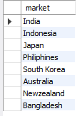
List of markets in which customer "Atliq Exclusive" operates its business in the APAC region.
1. These are the markets where we have to focus to make business strategy in the customer Atliq exclusive and in region APAC region.

Slide 3

What is the percentage of unique product increase in 2021 vs. 2020?
1. Percentage change is 15%. It indicates that releasing new unique products is potentially targeting new customer segment or market.
2. Taking decision of producing new products is successful.

Slide 4
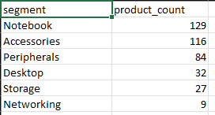
Unique product count in respect to each segment
We have to look upon the less sold items such as Networking ,storage.
We need to search the reason behind this low quantity sold (is there item supply location wrong for particular product category or some thing else)

Slide 5
Which segment had the most increase in unique products in 2021 vs 2020?
Peripherals Segment is showing the highest increase from 2020 to 2021.
Focus in this segment to increase the sales the number of purchase is more in this segment.

Slide 6

The products that have the highest and lowest manufacturing costs.
As the product AQ Master wired x1 Ms is having the lowest cost so try to make selling price more so that profit more.
Make supply of AQ HOME Allin1 Gen 2 to the most purchased location/demandable location so that the revenue is more.

Slide 7
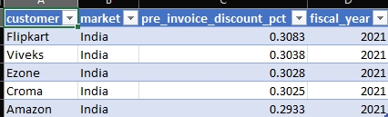
A report which contains the top 5 customers who received an average high pre invoice discount percentage for the fiscal year 2021 and in the Indian market.
These clients are our company’s big clients(buying bulk quantity) in India for next years give priority to these clients so that these clients are always satisfied by our product.

Slide 8
The complete report of the Gross sales amount for the customer “Atliq Exclusive” for each month .
Year 2021 is showing the more gross sales then any other year. It is less fluctuating. The peak sales happens in may month. Need to know what the reasons behind the increase on gross sales.
Year 2020 is most fluctuating(mostly due to Covid-19).The most peak sales happens in September month in 2020.

Slide 9

In which quarter of 2020, got the maximum total sold quantity?
1. Quarter 3 is showing the highest total sold quantity.
2. Focusing in months October, November, December
3. Mainly due to festive season the sold quantity risen.

Slide 10

Which channel helped to bring more gross sales in the fiscal year 2021 and the percentage of contribution?
Through retail channel around 73% market share these means goods are sold mostly by retailors rather then direct or distributer.
Giving incentives to the retailors so that they can buy our product more is recommended.

Slide 11
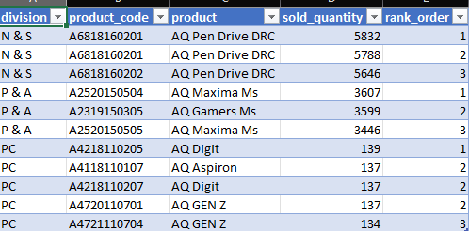
Get the Top 3 products in each division that have a high total sold quantity in the fiscal year 2021?
N & S division selling top sold quantity.
PC division selling the products in low quantity needed to know what is reason that this division is lagging behind.

